Slide 1
Chapter 4: Everything Can be Automated
Vịnh Nguyễn
Introduction to the Internet of Things v2.0
Notes:
Cisco Networking Academy Program
Introduction to the Internet of Things v2.0
Chapter 4: Everything Can be Automated

Slide 2
Instructor Materials – Chapter 4 Planning Guide
This PowerPoint deck is divided in two parts:
Instructor Planning Guide
Information to help you become familiar with the chapter
Teaching aids
Instructor Class Presentation
Optional slides that you can use in the classroom
Begins on slide # 9
Note: Remove the Planning Guide from this presentation before sharing with anyone.
Notes:
2

Slide 3
Chapter 4: Everything Can be Automated
Introduction to the Internet of Things v2.0 Planning Guide
Notes:
Cisco Networking Academy Program
Introduction to the Internet of Things
Chapter 4: Everything Can be Automated

Slide 4
Chapter 4: Activities
What activities are associated with this chapter?
Page # | Activity Type | Activity Name
4.1.1.2 | Activity | How is Automation Being Used?
4.1.1.3 | Lab | Lab – Automating Everyday Events
4.1.1.5 | Activity | Automation or Not Automation
4.1.1.6 | Packet Tracer | Explore the Smart Home
4.1.1.7 | Activity | Topic Assessment
4.1.2.3 | Lab | Design a Prototype of an AI Application
4.1.2.4 | Activity | Topic Assessment
4.1.3.3 | Video | The Network Intuitive
4.1.3.4 | Lab | Researching Intent-Based Networking (IBN)
4.1.3.5 | Activity | Topic Assessment
Notes:
4

Slide 5
Chapter 4: Assessment
Students should complete Chapter 4, “Assessment” after completing Chapter 4.
Quizzes, labs, topic assessments and other activities can be used to informally assess student progress.
Notes:
5

Slide 6
Chapter 4: Best Practices
Prior to teaching Chapter 4, the instructor should:
Complete Chapter 4 Quiz
Preview the labs, videos and activities.
Discuss the kinds of security students have implemented in their homes and/or on their personal devices.
Discuss the results of the risky behaviors lab.
Notes:
6

Slide 7
Chapter 4: Additional Help
For additional help with teaching strategies, including lesson plans, analogies for difficult concepts, and discussion topics, visit the Community Forums .
If you have lesson plans or resources that you would like to share, upload them to the Community Forums in order to help other instructors.
Students can enroll in Introduction to Packet Tracer (self-paced).
Notes:
7

Slide 9
Chapter 4: Everything Can be Automated
Introduction to the Internet of Things v2.0
Notes:
Cisco Networking Academy Program
Introduction to the Internet of Things
Chapter 4: Everything Can be Automated

Slide 10
Chapter 4 - Sections & Objectives
4.1 What Can be Automated?
Explain how digitization allows business processes to embrace automation.
Describe automation
Explain how artificial intelligence and machine learning impact automation.
Explain how intent-based networking adapts to changing business needs.
Notes:
10
Cisco Networking Academy Program
Introduction to the Internet of Things
Chapter 4: Everything Can be Automated

Slide 11
4.1 What Can Be Automated?
Notes:
4 – Everything Can be Automated
4.1 – What Can Be Automated

Slide 12
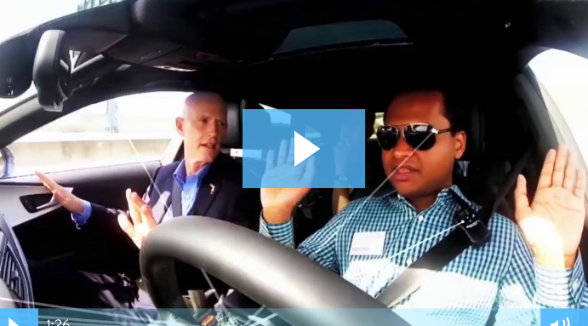
Automation What is Automation?
Automation is any process that is self-driven, reduces,and eventually eliminates, the need for human intervention.
The IoT opens up a new world in which tasks previously requiring human intervention can become automated.
Automation
Robots are used in dangerous conditions such as mining, firefighting, and cleaning up industrial accidents
used in automated assembly lines.
self-serve checkouts at stores
automatic building environmental controls
autonomous cars and planes.
Notes:
4.1 – What Can Be Automated?
4.1.1 – Automation
4.1.1.1 – What is Automation?

Slide 13
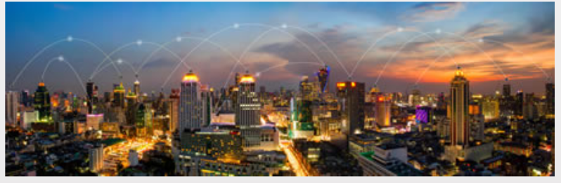
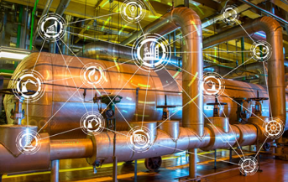
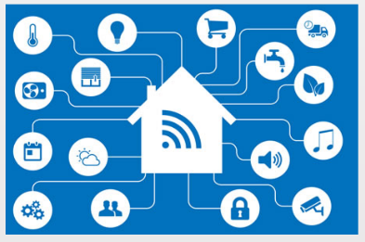
Automation How is Automation being Used?
Smart Home Automation
Smart Buildings
Industrial IoT and Smart Factories
Smart Cities
Smart Grid
Smart Cars
Stores and Services
Medical Diagnosis and Surgery
Aircraft Auto-Pilot
Notes:
4.1 – What Can Be Automated?
4.1.1 – Automation
4.1.1.2 – How is Automation being Used?

Slide 14
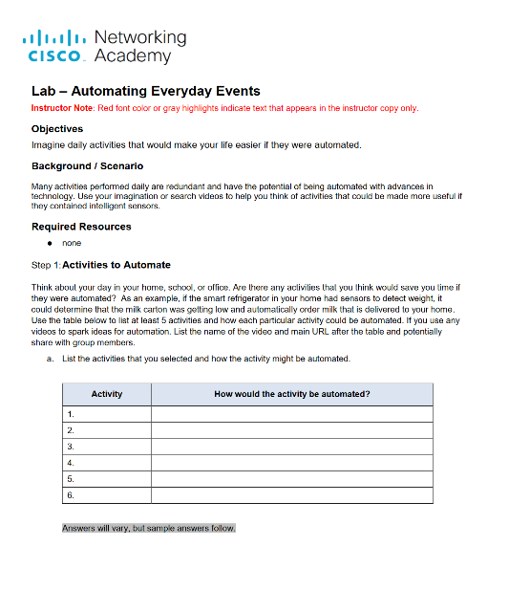
Automation Lab – Automating Everyday Events
Notes:
4.1 – What Can Be Automated?
4.1.1 – Automation
4.1.1.3 – Lab – Automating Everyday Events

Slide 15
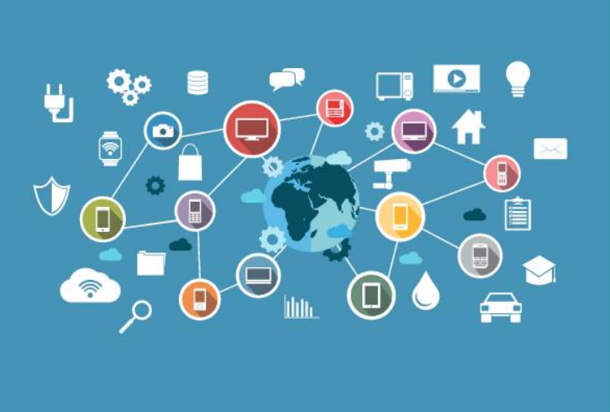
Automation When Things Start to Think
Many devices now incorporate smart technology to alter their behavior under certain circumstances.
can be as simple as a smart appliance lowering its power consumption during periods of peak demand or as complicated as a self-driving car.
Whenever a decision or course of action is taken by a device based on an outside piece of information, then that device is referred to as a smart device.
Notes:
4.1 – What Can Be Automated?
4.1.1 – Automation
4.1.1.4 – When Things Start to Think
4.1.1.5 - Activity – Automation or Not Automation

Slide 16
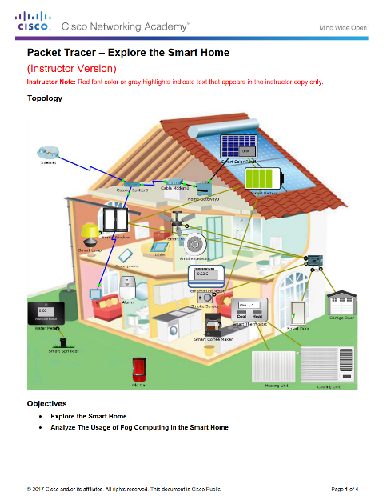
Automation Packet Tracer– Explore the Smart Home
Notes:
4.1 – What Can Be Automated?
4.1.1 – Automation
4.1.1.6 – Packet Tracer– Explore the Smart Home
4.1.1.7 – Topic Assessment

Slide 17
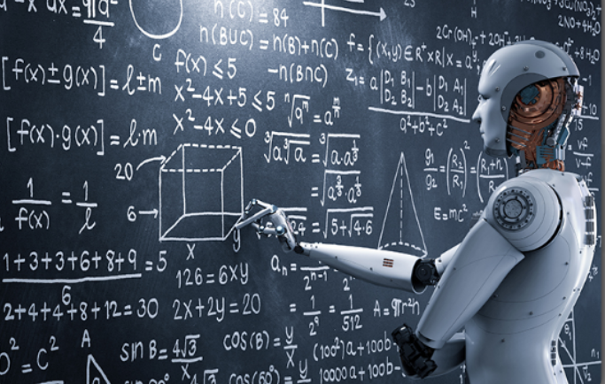
Artificial Intelligence (AI) and Machine Learning (ML) What Is Artificial Intelligence and Machine Learning?
Artificial Intelligence (AI) is the intelligence demonstrated by machines.
AI uses intelligent agents that can perceive their environment and make decisions.
AI refers to systems that mimic cognitive functions normally associated with human minds such as learning and problem solving.
Machine Learning (ML) is a subset of AI that uses statistical techniques to give computers the ability to “learn” from their environment.
This enables computers to improve on a particular task without being specifically programmed for that task.
Notes:
4.1 – What Can Be Automated?
4.1.2 – Artificial Intelligence (AI) and Machine Learning (ML)
4.1.2.1 – What Is Artificial Intelligence and Machine Learning?

Slide 18
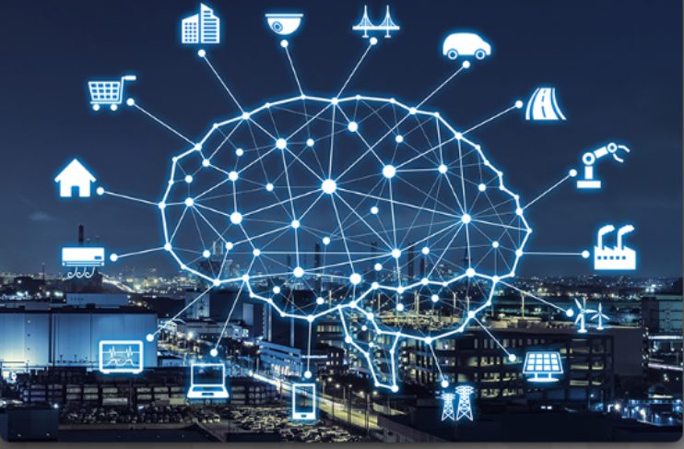
Artificial Intelligence (AI) and Machine Learning (ML) ML and the IoT
Common uses of ML technology include:
Speech Recognition – used in digital assistants.
Product Recommendation - Systems build up a customer profile and recommend products or services based on previous patterns.
Shape Recognition - Programs exist that allow crude hand-drawn diagrams and notes to be converted to more formal diagrams and text.
Credit Card Fraud Detection - A profile is constructed about the purchasing patterns of a client.
Facial Recognition
Notes:
4.1 – What Can Be Automated?
4.1.2 – Artificial Intelligence (AI) and Machine Learning (ML)
4.1.2.2 – ML and the IoT

Slide 19
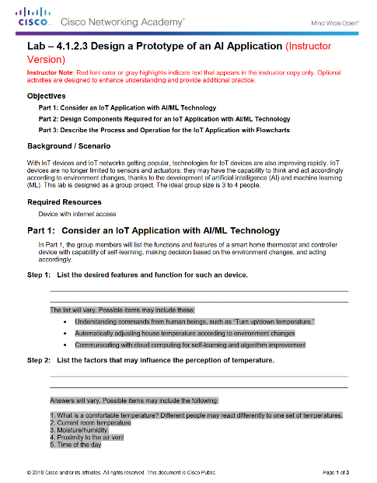
Automation Packet Tracer– Explore the Smart Home
Notes:
4.1 – What Can Be Automated?
4.1.2 – Automation
4.1.2.3 – Packet Tracer – Explore a Smart Home
4.1.2.4 – Topic Assessment

Slide 20
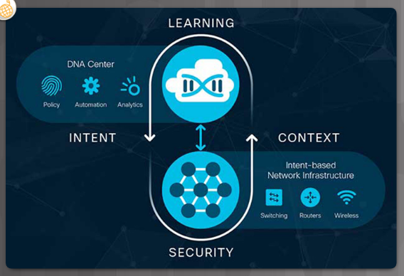
Intent-Based Networking What is Intent-Based Networking (IBN)
IT industry creating a systematic approach to tie infrastructure management to business intent (IBN).
Business network must seamlessly and securely integrate IoT devices, cloud-based services, and remote offices.
Network must secure these new digital initiatives from the ever-changing threat landscape.
Network must be responsive enough to quickly adapt to changes to security policies and procedures, business services and applications, and operational policies.
Notes:
4.1 – What Can Be Automated?
4.1.3 – Intent-Based Networking
4.1.3.1 – What is Intent-Based Networking (IBN)

Slide 21
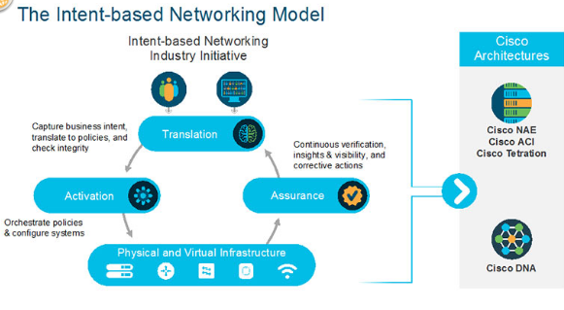
Intent-Based Networking How are ML, AI, and IBN Linked?
Intent-based networking harnesses the power of automation, AI and ML to control the function of a network to accomplish a specific purpose, or intent.
Network is able to translate the intent into policies and then use automation to deploy the appropriate configurations required.
Intent-based networking model consists of three key elements:
Assurance - end-to-end verification of network-wide behavior.
Translation - ability to apply business intent to network configuration.
Activation - occurs after the intent has been specified and the policies created.
Notes:
4.1 – What Can Be Automated?
4.1.3 – Intent-Based Networking
4.1.3.2 – How are ML, AI, and IBN Linked?

Slide 22
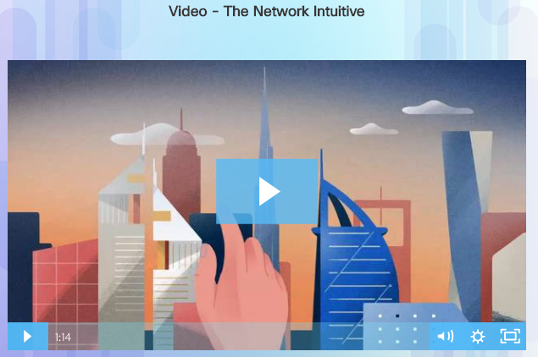
Intent-Based Networking Use Cases for Intent-Based Networking
Intent-based networking allows the company to focus on business goals.
Provides an automated system that understands what the organization needs and then makes it happen.
Cisco Digital Network Architecture (Cisco DNA) is an example of an intent-based network.
Open, extensible, software-driven architecture.
Accelerates and simplifies enterprise network operations, while lowering costs and reducing risks.
https://www.cisco.com/c/en/us/solutions/enterprise-networks/index.html
Notes:
4.1 – What Can Be Automated?
4.1.3 – Intent-Based Networking
4.1.3.3 – Use Cases for Intent-Based Networking

Slide 23
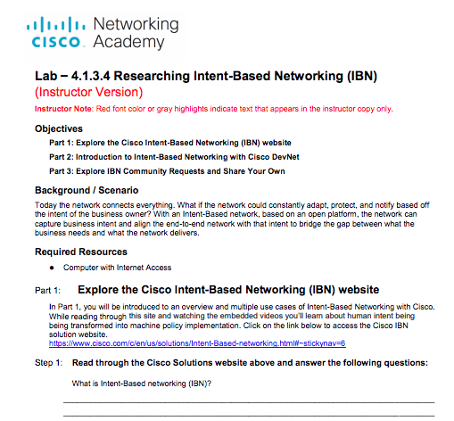
Intent-Based Networking Lab – Researching Intent-Based Networking (IBN)
Notes:
4.1 – What Can Be Automated?
4.1.3 – Intent-Based Networking
4.1.3.4 – Lab – Researching Intent-Based Networking (IBN)
4.1.3.5 – Topic Assessment

Slide 24
4.2 Chapter Summary
Notes:
4 – Everything Can Be Automated
4.2 - Summary

Slide 25
Chapter Summary Summary
.
Notes:
4 – Everything Can Be Connected
4.2 – Summary
4.2.1.1 - Summary

